Slide 1
ShowNet Icons
INTEROP TOKYO NOC TEAM
June 9, 2014

Slide 2
before you begin
install cmtt10.ttf font from CTAN
http://www.ctan.org/tex-archive/fonts/cm/ps-type1/bakoma/ttf/
reload
have fun

Slide 3
legend

Slide 4
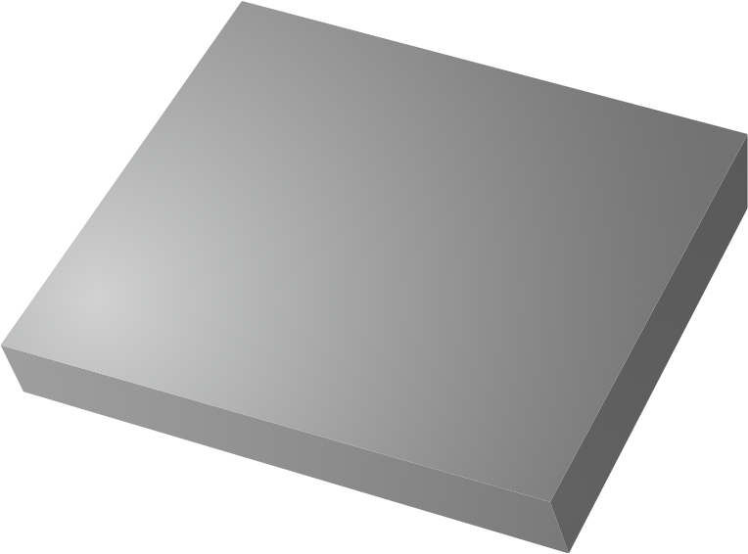











































L7
server
MODEL
storage
MODEL
serial-server
MODEL
terminal
MODEL
endnode
pstn
L4-7
cache
MODEL
cgn,balancer
MODEL
firewall
MODEL
vpn
MODEL
security
MODEL
outpost
MODEL
mgmt
L3
.1
1.1
router
MODEL
cpe,homerouter
MODEL
loopback
transit
net_addr
mep-id
6
mip
L2
10
switch
MODEL
ap
MODEL
eoam
vlan-id
public-peer
net_addr
L1
3
dpi
MODEL
mirror
MODEL
dwdm
MODEL
tap
MODEL
sdn, etc
net_addr
*
tester
MODEL
openflow
MODEL
controller
MODEL

Slide 5
diagram example #1
external

Slide 6
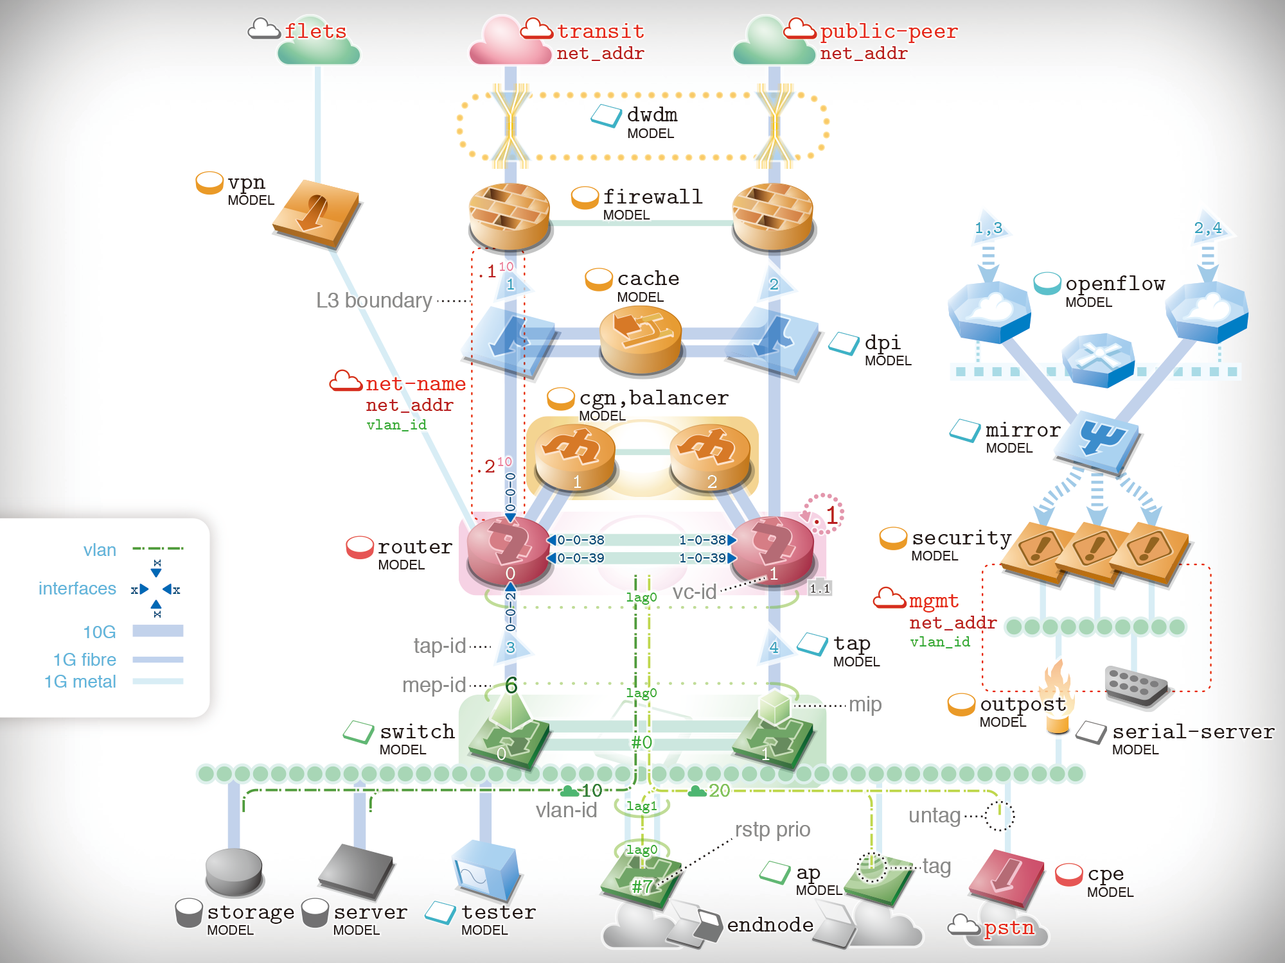
Illustrator

Slide 7




PowerPoint
flets
transit
net_addr
public-peer
net_addr
dwdm
MODEL
vpn
MODEL
firewall
MODEL
1,3
2,4
.1¹⁰
cache
MODEL
openflow
MODEL
L3 boundary
1
2
dpi
MODEL
net-name
net_addr
vlan_id
cgn,balancer
MODEL
mirror
MODEL
.2¹⁰
1
2
0-0-0
.1
vlan
x
router
MODEL
0-0-38
1-0-38
security
MODEL
0
0-0-39
1-0-39
1
interfaces
x
x
lag0
vc-id
1.1
mgmt
net_addr
vlan_id
10G
x
0-0-2
tap-id
3
4
tap
MODEL
1G fibre
6
1G metal
mep-id
lag0
outpost
MODEL
mip
switch
MODEL
#0
serial-server
MODEL
0
1
10
lag1
20
vlan-id
rstp prio
untag
lag0
ap
MODEL
tag
cpe
MODEL
#7
storage
MODEL
server
MODEL
tester
MODEL
endnode
pstn

Slide 8
diagram example #2
typical network

Slide 9
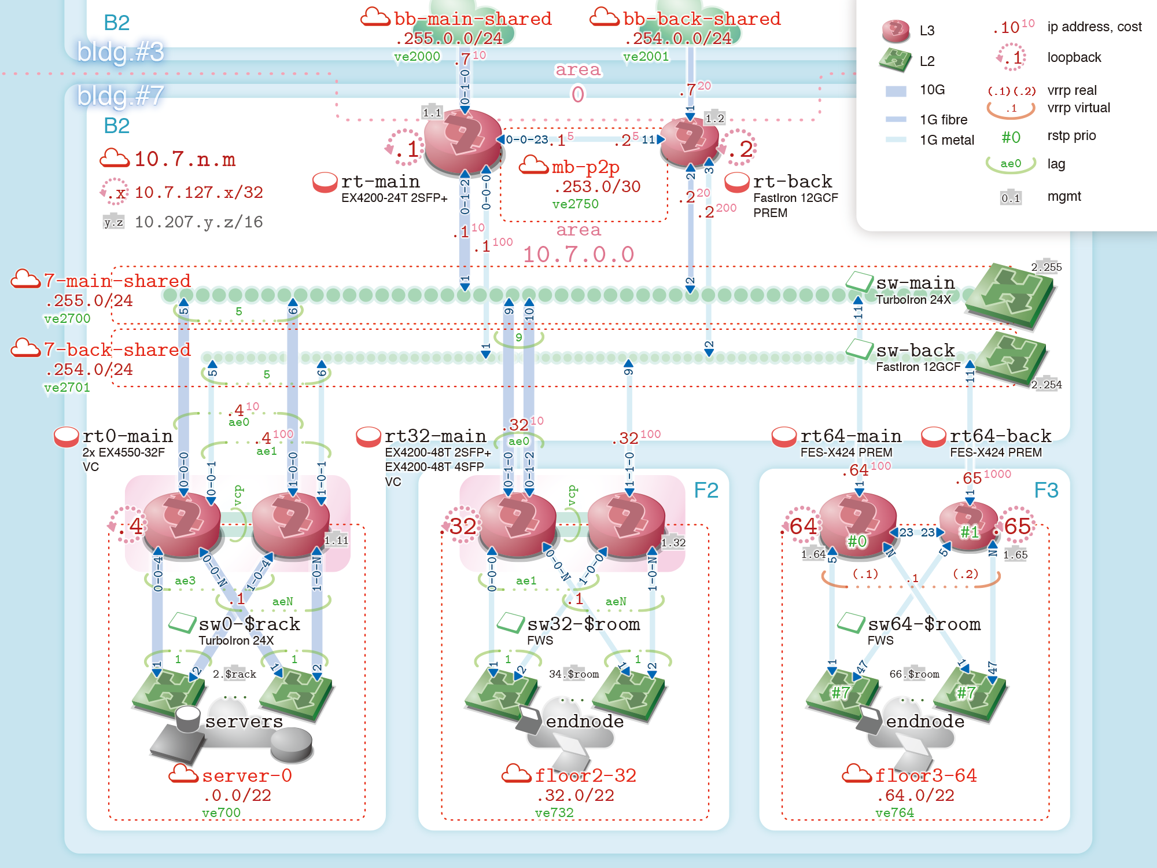
Illustrator

Slide 10
B2
bb-main-shared
.255.0.0/24
ve2000
bb-back-shared
.254.0.0/24
ve2001
L3
.10¹⁰
ip address, cost
bldg.#3
.7¹⁰
.1
loopback
area
0
L2
bldg.#7
0-1-0
.7²⁰
10G
(.1)
(.2)
vrrp real
1
.1
vrrp virtual
B2
1.1
1.2
1G fibre
.1
.1⁵
.2⁵
.2
#0
rstp prio
10.7.n.m
0-0-23
11
1G metal
rt-main
EX4200-24T 2SFP+
mb-p2p
.253.0/30
ve2750
rt-back
FastIron 12GCF
PREM
ae0
lag
.x
10.7.127.x/32
3
2
0-0-0
.2²⁰
0.1
mgmt
0-1-2
.2²⁰⁰
y.z
10.207.y.z/16
.1¹⁰
area
10.7.0.0
.1¹⁰⁰
7-main-shared
.255.0/24
ve2700
1
2
sw-main
TurboIron 24X
2.255
5
9
11
5
6
1
10
2
7-back-shared
.254.0/24
ve2701
9
sw-back
FastIron 12GCF
5
5
6
9
11
2.254
.4¹⁰
.32¹⁰
rt0-main
2x EX4550-32F
VC
ae0
.4¹⁰⁰
rt32-main
EX4200-48T 2SFP+
EX4200-48T 4SFP
VC
.32¹⁰⁰
rt64-main
FES-X424 PREM
rt64-back
FES-X424 PREM
ae1
ae0
0-0-0
1-0-0
0-1-0
.64¹⁰⁰
0-0-1
1-0-1
0-1-2
1-1-0
1
.65¹⁰⁰⁰
vcp
vcp
F2
1
F3
.4
.32
.64
23
#1
.65
1.11
1.32
#0
23
1.64
5
1.65
0-0-N
N
N
0-0-4
ae3
0-0-N
1-0-4
0-0-N
0-0-0
ae1
1-0-0
1-0-N
5
(.1)
.1
(.2)
.1
aeN
.1
aeN
sw0-$rack
TurboIron 24X
sw32-$room
FWS
sw64-$room
FWS
1
2
1
2
1
2
1
2
1
47
1
47
1
2.$rack
1
1
34.$room
1
66.$room
...
...
#7
...
#7
servers
endnode
endnode
server-0
.0.0/22
ve700
floor2-32
.32.0/22
ve732
floor3-64
.64.0/22
ve764
PowerPoint

Slide 11
diagram example #3
virtualization

Slide 12
cgn,balancer
MODEL
.3
0-0-0
1
2
.1
network
0-0-38
1-0-38
0
0-0-39
1-0-39
1
router
MODEL
1.1
lag0
hv based
.3
sax0
SoftAX
sax1
SoftAX
vya0
Vyatta
.3
.4
vya1
Vyatta
vip{0,1}
VIPRION 2400
.1
.2
.1
.2
ins{0,1}
routing-instance
vsw0
vSwitch
sw0
MXL stack
core0
2x EX4550
blade0
ESXi on M1000e
blade1
ESXi on M1000e
lag0
ae0
hardware
based

Slide 13
server
lag0
omote
san
nas0
FreeBSD
iscsi0
Storwize
nfs
server{0..3}
MODEL
storage
MODEL
server
MODEL
blade0
ESXi on BladeCenter
security
vsw0
Nexus 1000V
blade0
UCS 5108
security
MODEL
security
MODEL
vsw1
Nexus 1000V

Slide 14
working environment
icons: Illustrator CS6 Mac
edit: PowerPoint 2011 for Mac

Slide 15
all materials and objects
in this file are made by Interop community for past 10+ years, and can be used or reproduced without any permission from us. Citation of this source is very much appreciated.

Slide 16
INTEROP TOKYO NOC TEAM http://interop.jp
designed by field trial by
Hiroki Kawaguchi Ryo Nakamura and Yuya Kawakami

